Slide 1
Server-side Programming: Java Servlets

Slide 2
What is a Servlet?
Servlet is a technology i.e. used to create web application.
Servlet is an API that provides many interfaces and classes including documentations.
Servlet is an interface that must be implemented for creating any servlet.
Servlet is a class that extends the capabilities of the servers and responds to the incoming requests. It can respond to any type of requests.
Servlet is a web component that is deployed on the server to create dynamic web page.

Slide 3
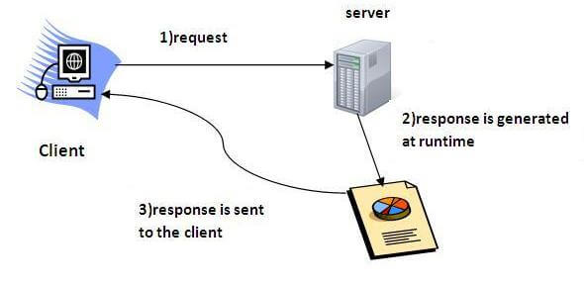

Slide 4
CGI(Commmon Gateway Interface)
CGI technology enables the web server to call an external program and pass HTTP request information to the external program to process the request.
For each request, it starts a new process.

Slide 5
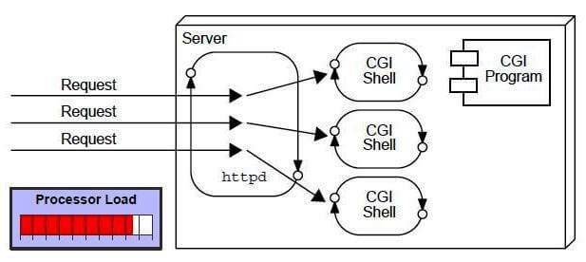

Slide 6
Disadvantages of CGI
There are many problems in CGI technology:
If number of clients increases, it takes more time for sending response.
For each request, it starts a process and Web server is limited to start processes.
It uses platform dependent language e.g. C, C++, perl.

Slide 7
Advantage of Servlet
The web container creates threads for handling the multiple requests to the servlet.
Threads have a lot of benefits over the Processes such as they share a common memory area, lightweight, cost of communication between the threads are low.

Slide 8
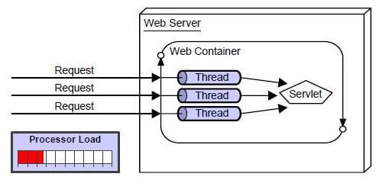

Slide 9
The basic benefits of servlet are as follows:
Better performance: because it creates a thread for each request not process.
Portability: because it uses java language.
Robust: Servlets are managed by JVM so we don't need to worry about memory leak, garbage collection etc.
Secure: because it uses java language

Slide 10
Benefits of servlet
.
Portability
Powerful
Efficiency
Safety
Integration
Extensibility
Inexpensive
Secure
Performance

Slide 11
Java Servlet
Javax.servlet package can be extended for use with any application layer protocol
http is the most popularly used protocol
Javax.servlet.http package is extension of the javax.servlet package for http protocol
The Servlet spec allows you to implement separate Java methods implementing each HTTP method in your subclass of HttpServlet.
Override the doGet() and/or doPost() method to provide normal servlet functionality.
Override doPut() or doDelete() if you want to implement these methods.
There's no need to override doOptions() or doTrace().
The superclass handles the HEAD method all on its own.

Slide 12
Anatomy of a Servlet
init()
destroy()
service()
doGet()
doPost()
Notes:
Init() – the init() function is called when the servlet is initialized by the server. This often happens on the first doGet() or doPut() call of the servlet.
Destroy()- this function is called when the servlet is being destroyed by the server, typically when the server process is being stopped.
doGet() – the doGet() function is called when the servlet is called via an HTTP GET.
doPost() – the doPost() function is called when the servlet is called via an HTTP POST.
POSTs are a good way to get input from HTML forms
service() – public function that handles dispatching requests to the protected HTTP-specific service() method;

Slide 13
Servlet API life cycle methods
init(): called when servlet is instantiated; must return before any other methods will be called
service(): method called directly by server when an HTTP request is received; default service() method calls doGet() (or related methods covered later)
destroy(): called when server shuts down

Slide 14
Servlet Container
Create Thread Pool
Thread
Thread
Instantiate servlet
Servlet
Call init ( ) method
Perform Initialization
HTTP Request 1
Call service ( ) method
Allocate request to thread
HTTP Request 2
Call service ( ) method
Allocate request to thread
Perform Service
Shutdown Initiated
Block all further requests Wait for active threads to end
Perform Service
HTTP Response 1
Terminate thread pool
HTTP Response 2
call destroy ( ) method
Perform cleanup
terminate servlet
Servlet destroyed & garbage collected
Container shutdown

Slide 15
Anatomy of a Servlet
HTTPServletRequest object
Information about an HTTP request
Headers
Query String
Session
Cookies
HTTPServletResponse object
Used for formatting an HTTP response
Headers
Status codes
Cookies

Slide 16
Server-side Programming
The combination of
HTML
JavaScript
DOM is sometimes referred to as Dynamic HTML (DHTML)
Web pages that include scripting are often called dynamic pages (vs. static)

Slide 17
Server-side Programming
Similarly, web server response can be static or dynamic
Static: HTML document is retrieved from the file system and returned to the client
Dynamic: HTML document is generated by a program in response to an HTTP request
Java servlets are one technology for producing dynamic server responses
Servlet is a class instantiated by the server to produce a dynamic response

Slide 18
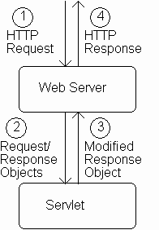
Servlet Overview

Slide 19
Servlet Overview Reading Data from a Client
When server starts it instantiates servlets
Server receives HTTP request, determines need for dynamic response
Server selects the appropriate servlet to generate the response, creates request/response objects, and passes them to a method on the servlet instance
Servlet adds information to response object via method calls
Server generates HTTP response based on information stored in response object

Slide 20
The browser uses two methods to pass this information to web server. These methods are GET Method and POST Method.
GET Method (doGet())
The GET method sends the encoded user information appended to the page request. The page and the encoded information are separated by the ?(question mark) symbol as follows −
http://www.test.com/hello?key1 = value1&key2 = value2

Slide 21
POST Method
A generally more reliable method of passing information to a backend program is the POST method.
This packages the information in exactly the same way as GET method, but instead of sending it as a text string after a ? (question mark) in the URL it sends it as a separate message.
This message comes to the backend program in the form of the standard input which you can parse and use for your processing.
Servlet handles this type of requests using doPost() method.

Slide 22
Servlets handles form data parsing automatically using the following methods depending on the situation −
getParameter() − You call request.getParameter() method to get the value of a form parameter.
getParameterValues() − Call this method if the parameter appears more than once and returns multiple values, for example checkbox.
getParameterNames() − Call this method if you want a complete list of all parameters in the current request.

Slide 23
Example

Slide 24
All servlets we will write
are subclasses of
HttpServlet

Slide 25
Server calls doGet() in response to GET request

Slide 26
Interfaces implemented by request/response objects

Slide 27
Production servlet should
catch these exceptions

Slide 28
First two
things done
by typical servlet;
must be in this
order

Slide 29
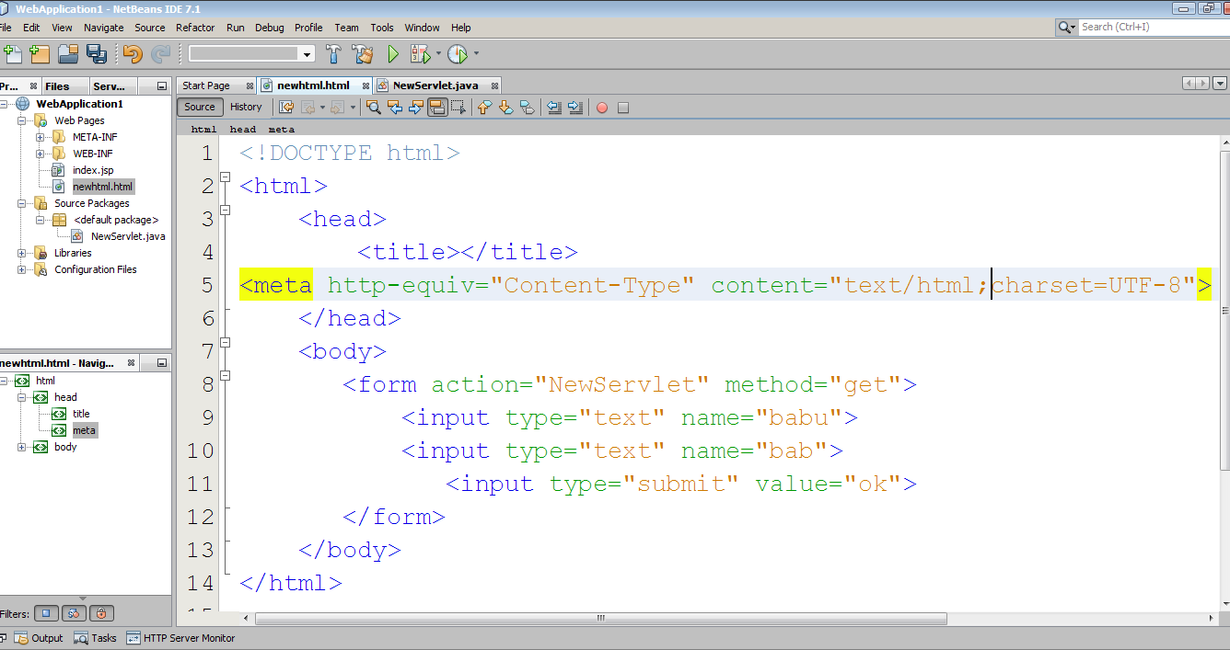

Slide 30
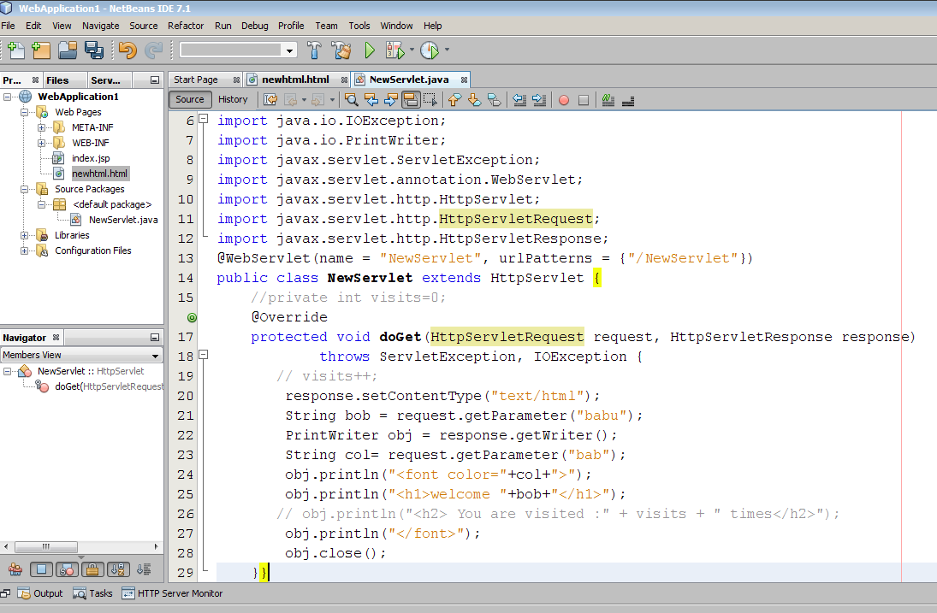
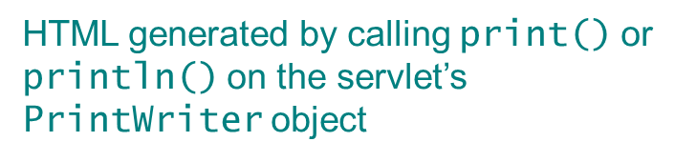
Good practice to explicitly close
the PrintWriter when done

Slide 31
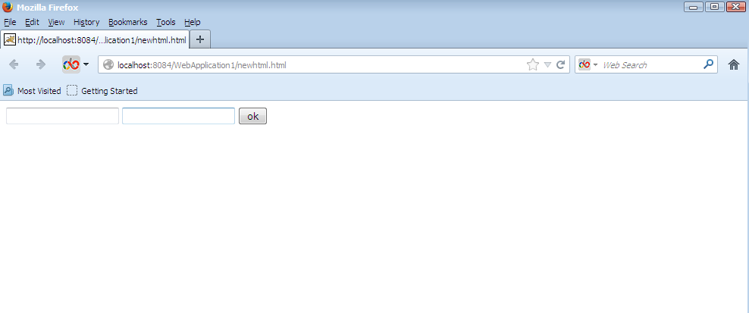

Slide 32
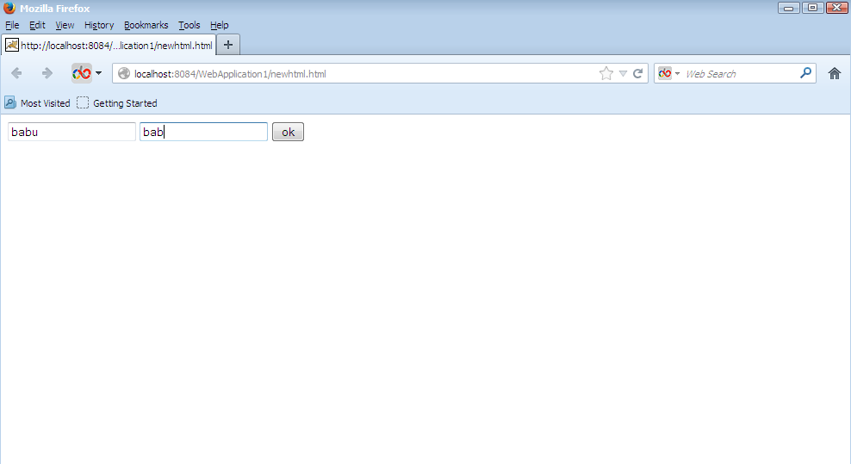

Slide 33
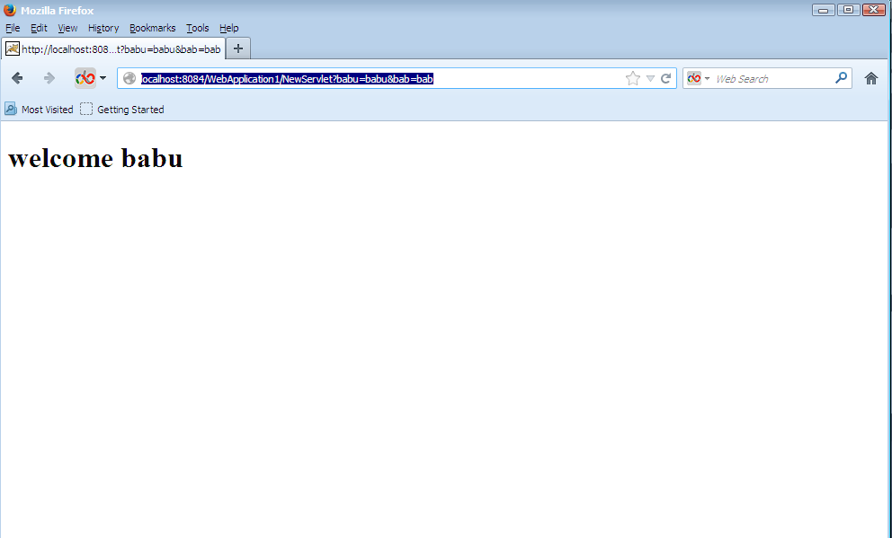

Slide 34
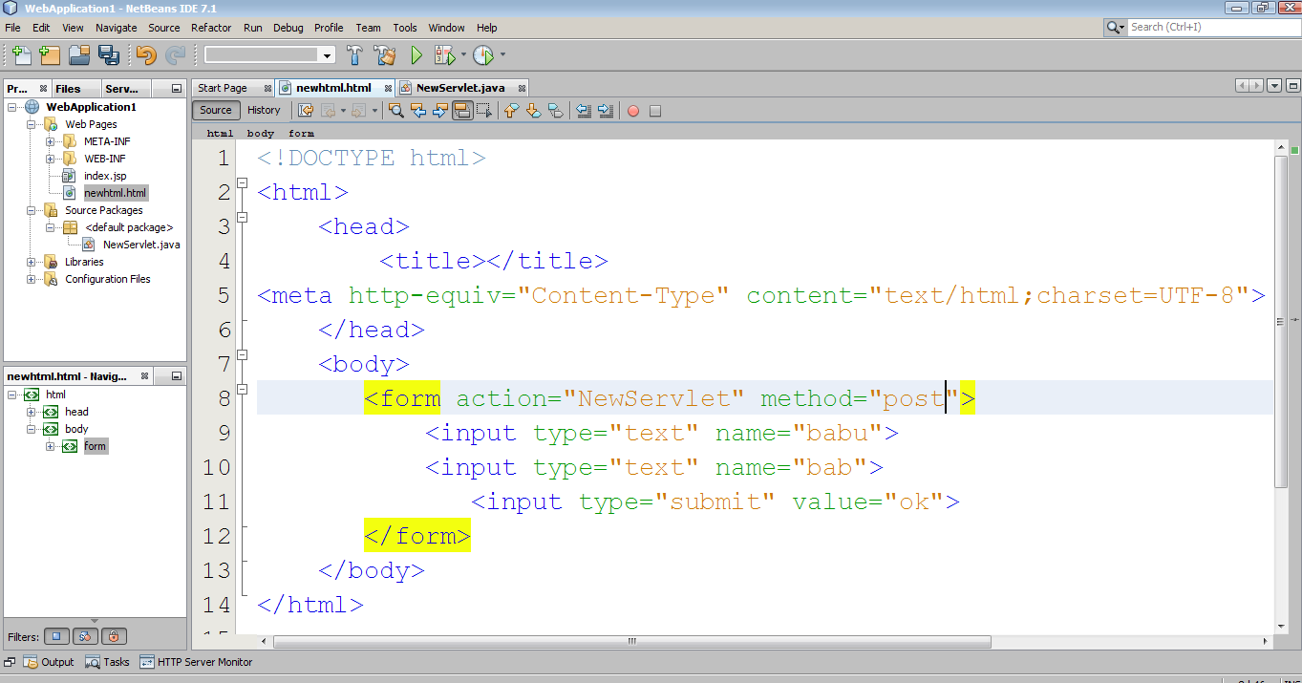

Slide 35
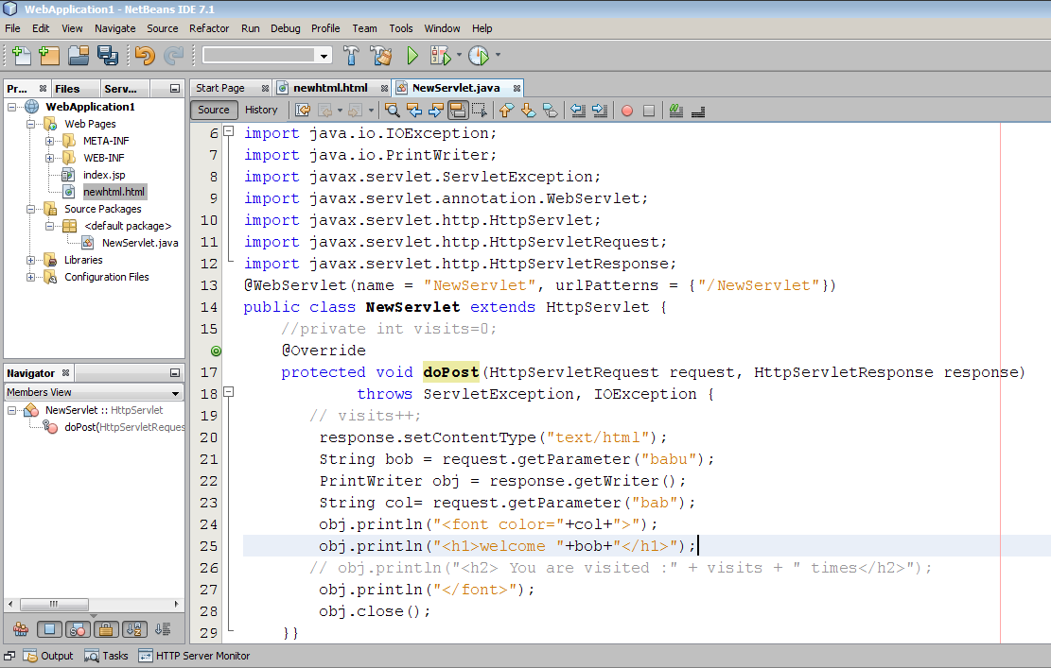

Slide 36
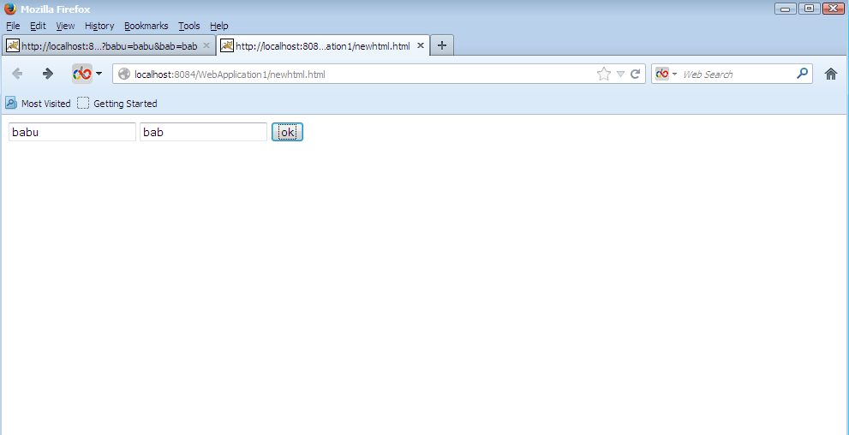

Slide 37
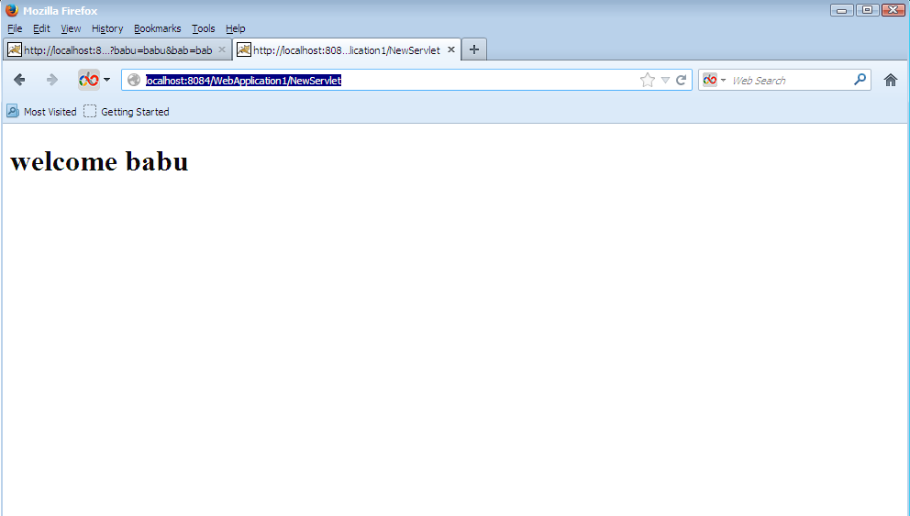

Slide 38
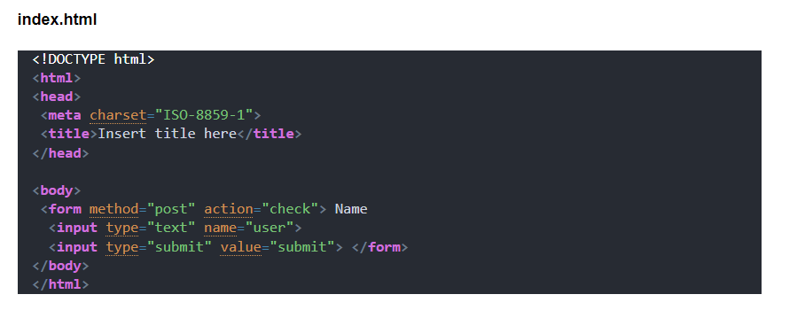

Slide 39
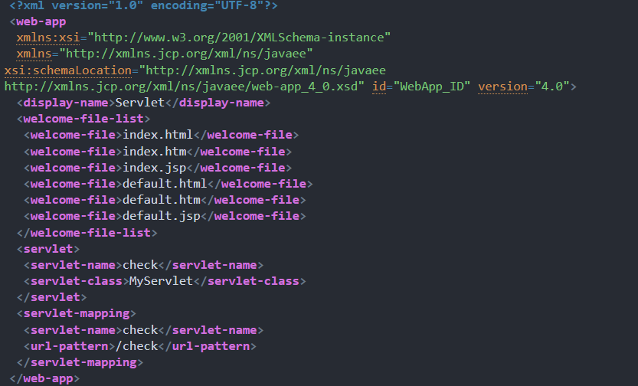

Slide 40
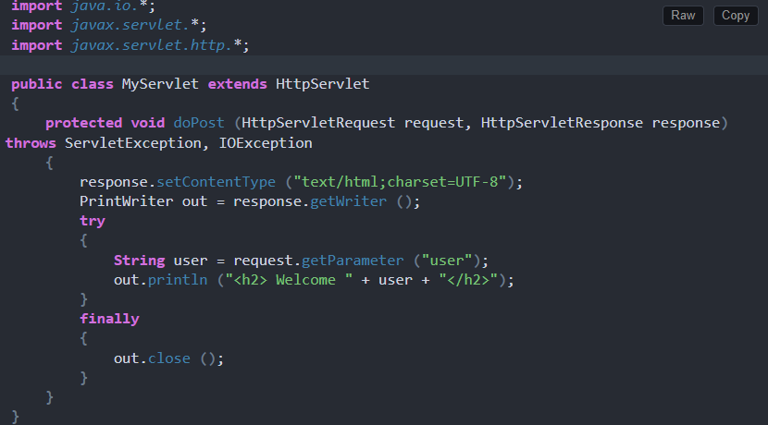

Slide 41
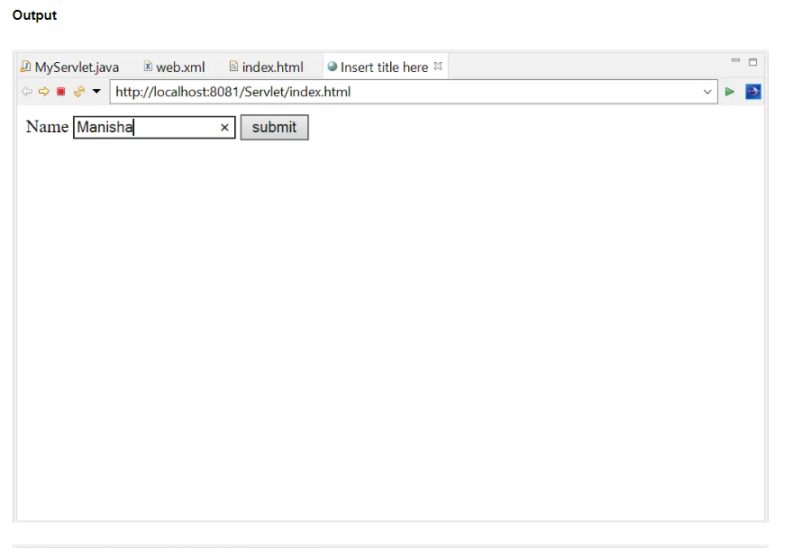

Slide 42
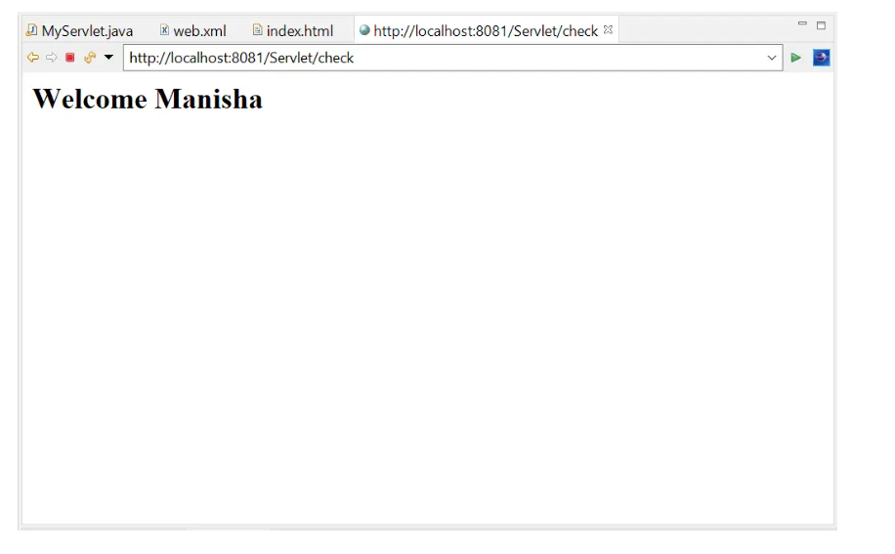

Slide 43
Deployment Descriptor or web.xml file:
Deployment Descriptor is a web.xml file, it can be used to provide the metadata about the present web application required by the container in order to perform a particular server-side action. In the web application, the web.xml file includes the following configuration details with respect to. the web application.
Welcome File Configuration
Display Name Configuration
Servlets Configuration
Filters Configuration
Listeners Configuration
Context Parameters Configuration
Session Time Out Configuration
Load On Startup Configuration
Initialization Parameters Configuration
Session Time Out Configuration
Load On Startup Configuration
Error Page Configuration
Tag Library Configuration
Security Configuration

Slide 44
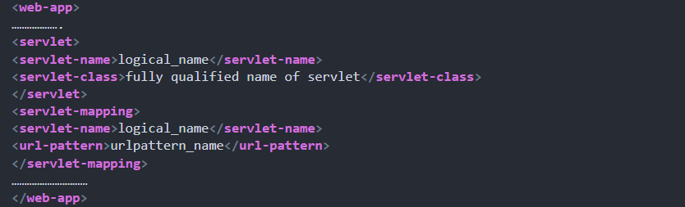

Slide 45
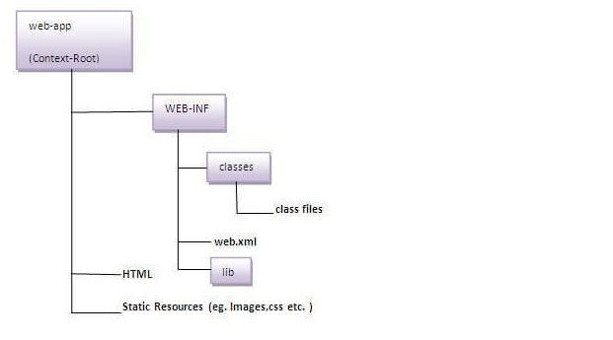
Directory Heirarchy

Slide 46
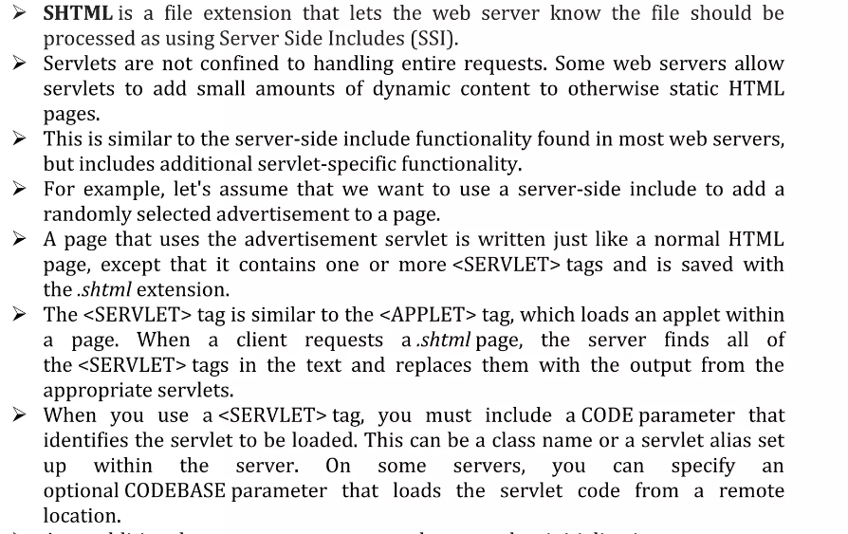
SSI

Slide 47
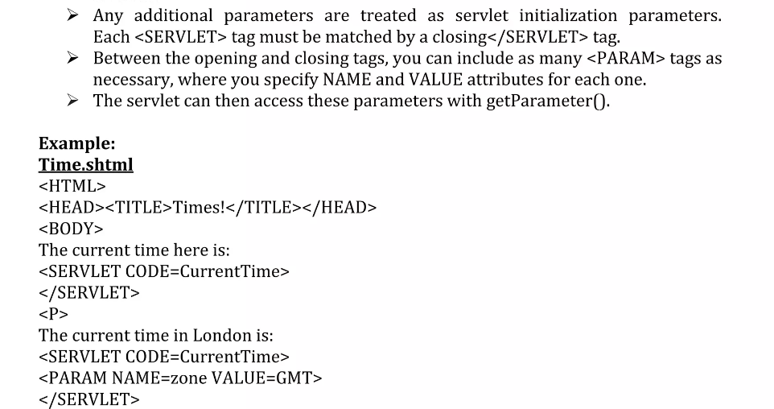
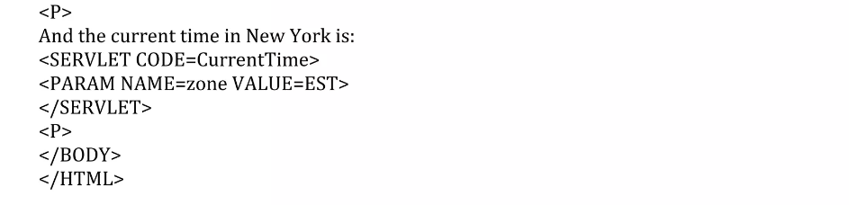

Slide 48
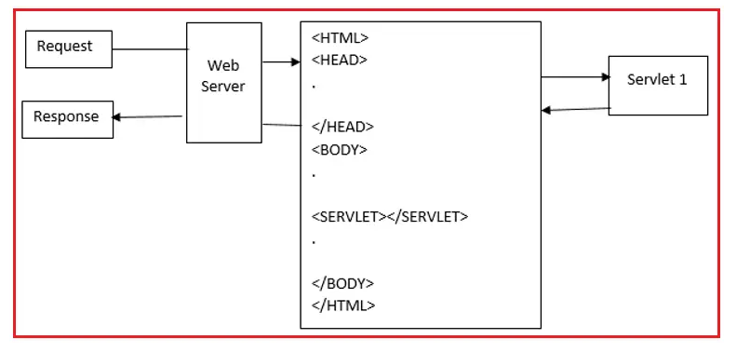

Slide 49
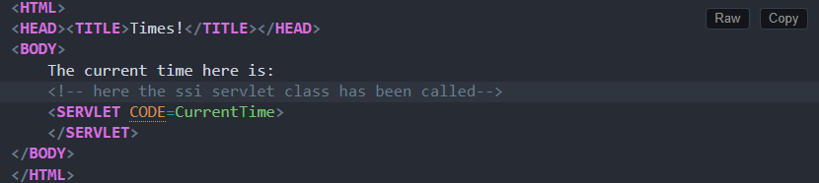

Slide 50
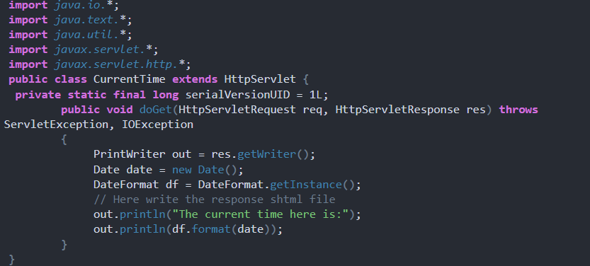

Slide 51
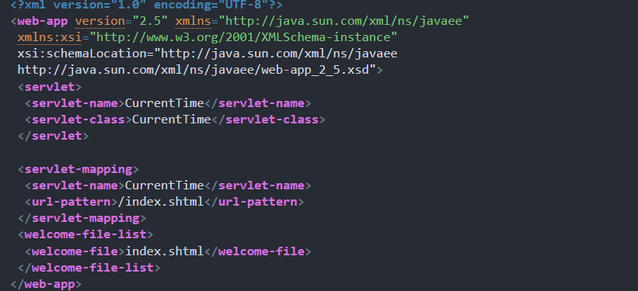

Slide 52
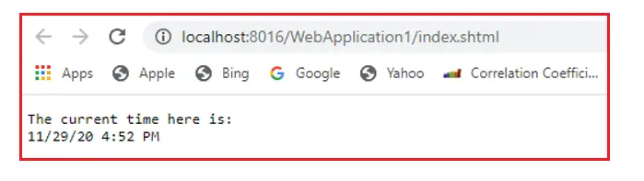

Slide 53
RequestDispatcher in Servlet
The RequestDispatcher interface provides the facility of dispatching the request to another resource it may be html, servlet or jsp. This interface can also be used to include the content of another resource also. It is one of the way of servlet collaboration.
There are two methods defined in the RequestDispatcher interface.
1) Include Mechanism
Include Request Dispatching mechanism can be used to include the target resource response into the present resource response. In the case of the Include mechanism, when we send a request to the first resource then the container will prepare request and response objects, by executing some part in the first resource container may generate some response in the response object.
public void include(ServletRequest req, ServletResponse res) throws ServletException, IOException

Slide 54
2) Forward:
In web applications, the main purpose of the Forward mechanism is to forward requests from the present resource to the target resource. In the case of the Forward mechanism, when we send a request to the first resource then the container will create request and response objects, executing some part in the first resource container may generate some response in the response object.
public void forward(ServletRequest req, ServletResponse res) throws ServletException, IOException
To get an object-
public RequestDispatcher getRequestDispatcher(String resource);

Slide 55
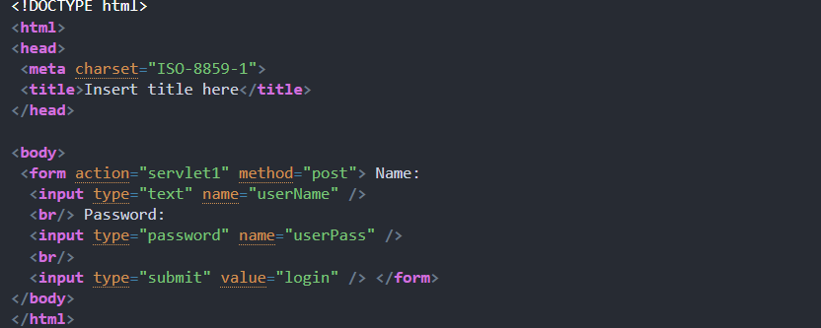

Slide 56
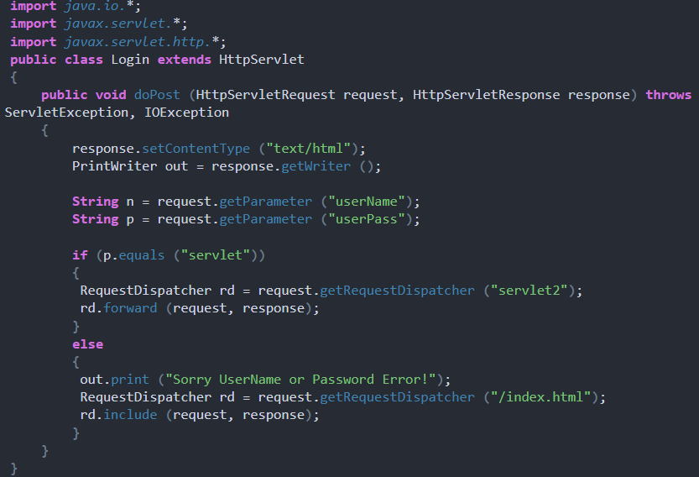

Slide 57
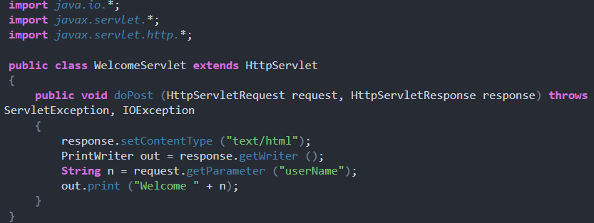

Slide 58
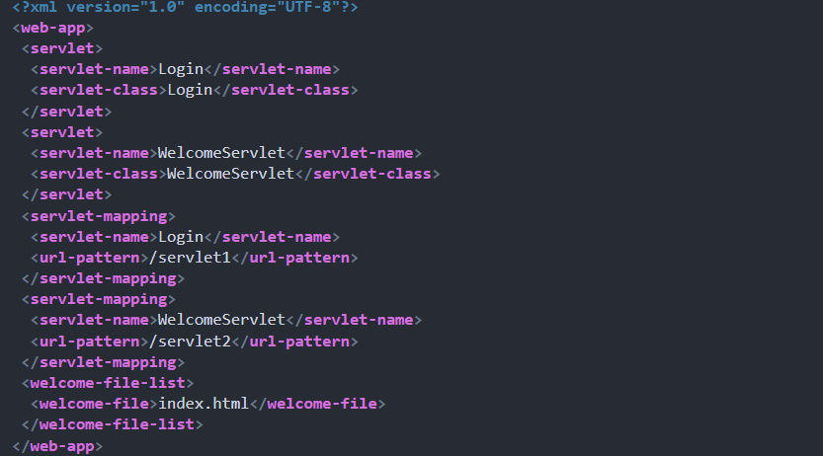

Slide 59
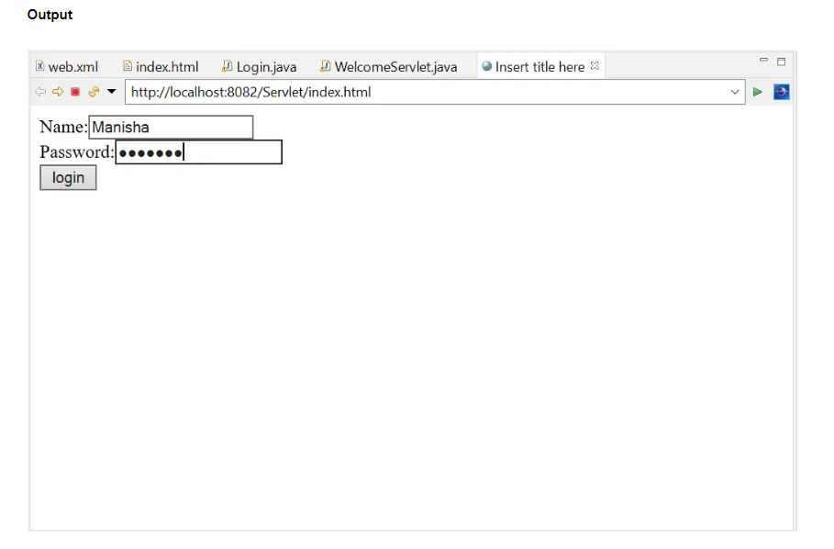

Slide 60
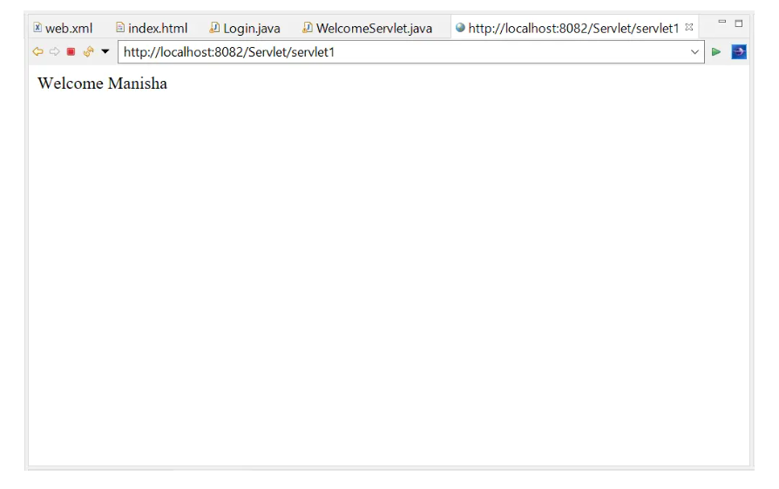

Slide 61
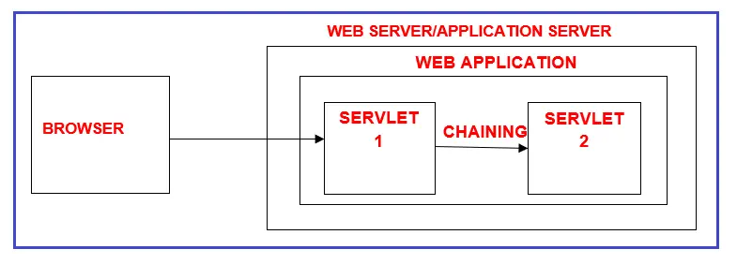
Servlet Chaining
Taking the request from a browser window and processing that request by using multiple servlets as a chain is called servlet chaining. In servlet chaining, we perform communication between servlet programs to process the request given by a client.
All servlet programs that participate in a servlet chaining will use the same request and response objects because they process the same request that is given by the client.
To perform servlet chaining we need the RequestDispatcher object.

Slide 62
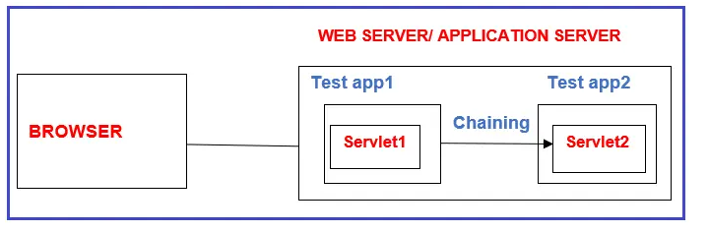
Here servlet1 should use ServletContext object based RequestDispatcher object.
The request object based RequestDispatcher object expects that the source servlet program and destination web resource program must be in the same web application. The ServletContext object-based RequestDispatcher object allows to keep the source servlet program and destination web resource program either in the same web application or in two different web applications of the same server but they cannot be there in two different web application of two different servers.

Slide 63
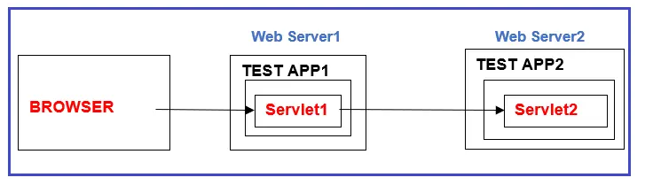
This kind of servlet chaining is not possible with the RequestDispatcher object, we need to use the Send Redirection concept. So, servlet chaining is all about performing servlet-servlet communication or we can say inter-servlet communication.

Slide 64
Request Redirection in Servlet
The process of bypassing the request from one web application to another web application is called Request Redirection. In web applications, we are able to achieve Request Redirection by using Send Redirect Mechanism.
To perform Request Redirection, if we use Send Redirect Mechanism no need to use Hyperlinks, not required to set status code and Response Header values to the Response Format, but we need to use the following method:
Syntax: public void sendRedirect(String url)
The sendRedirect() method is used to redirects the response to another resource. It is the method of HttpServletResponse interface. It makes the browser to create a new request to get to the resource. The client can directly see the new URL in the browser. It accepts both the relative and absolute URL so that it can work both inside and outside the server.

Slide 65
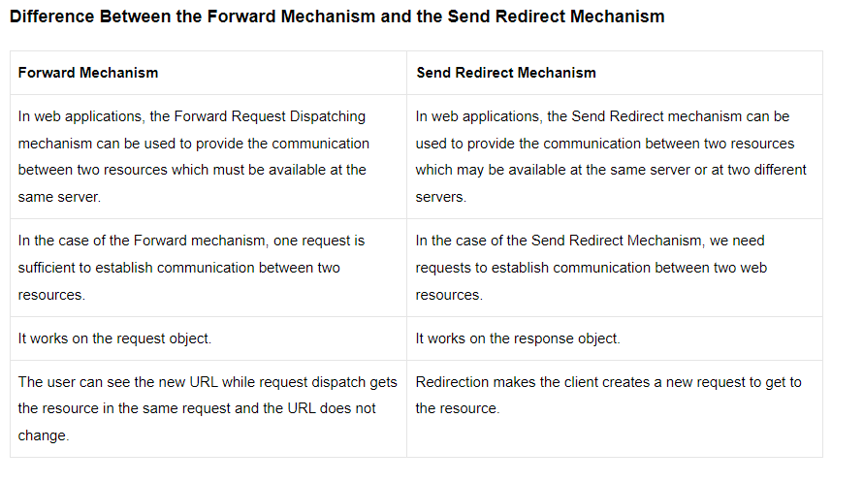

Slide 66
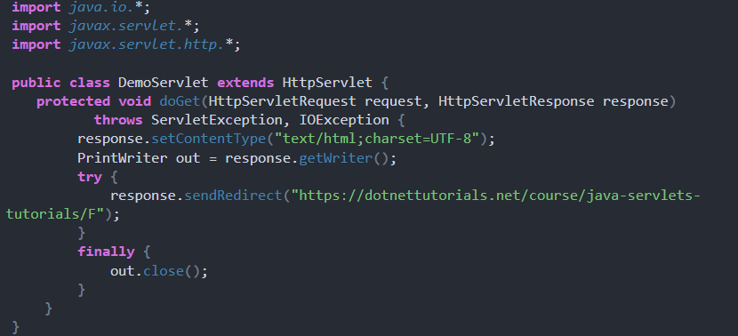

Slide 67
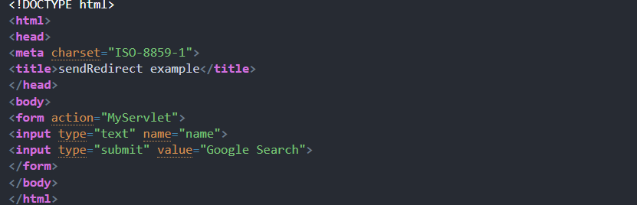

Slide 68
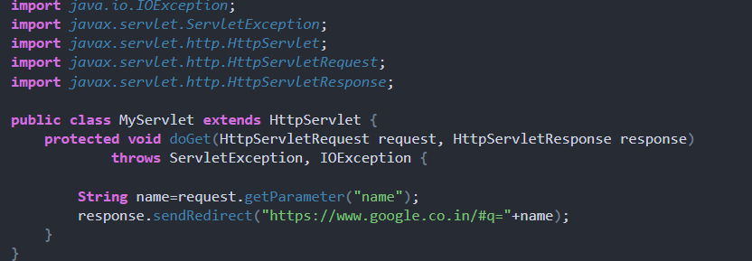

Slide 69
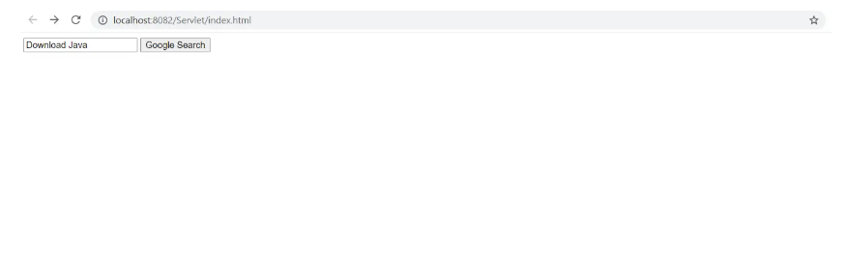
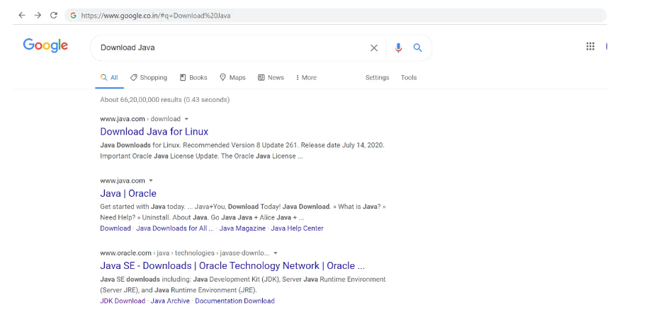

Slide 70
ServletConfig Interface
ServletConfig is an object, it’ll store all the configuration details of a specific servlet, where the configuration details include the logical name of the servlet, initialization parameters, reference of ServletContext object, and so on.
It’ll provide the entire view of a specific servlet. In the web application, the container will prepare ServletConfig objects individually to every and each servlet.
The container will prepare ServletCofig object immediately after servlet instantiation and just before calling init() method in servlet initialization. The container will destroy the ServletConfig object just before servlet de-instantiation. Due to the above reasons, the life cycle of the ServletConfig object is up to a specific servlet.
If we declare any data in the ServletConfig object then that data is going to be shared up to the respective servlet. Due to the above reasons, the scope of the ServletConfig object is up to a particular servlet.

Slide 71
ServletConfig object can be created and removed only by the server, not by the programmer.
ServletConfig object is created when the client sends the request to the particular servlet and when the servlet object is created.
ServletConfig object will be removed by the server when we close the server or when the servlet is deleted from the project.
One ServletConfig object is created for one Servlet it means in one project we can contain multiple ServletConfig objects based on the multiple servlets available.
This servletConfig object can be used only by the particular servlet which contains the ServletConfig object.
But the ServletConfig object of one servlet cannot be used by any other servlet which maybe belongs to the same or other projects.
Advantage: No need to update in web.xml if any changes occur.

Slide 72
ServletConfig methods
getInitParameter(java.lang.String name): It is used to return a String containing the value of the named initialization parameter, or null if the parameter does not exist.
getInitParameterNames(): It returns the names of the servlet’s initialization parameters as an Enumeration of String objects, or an empty Enumeration if the servlet has no initialization parameters.
getServletContext(): It returns a reference to the ServletContext in which the caller is executing.
getServletName(): It returns the name of this servlet instance.
Syntax:
ServletConfig config = getServletConfig();

Slide 73
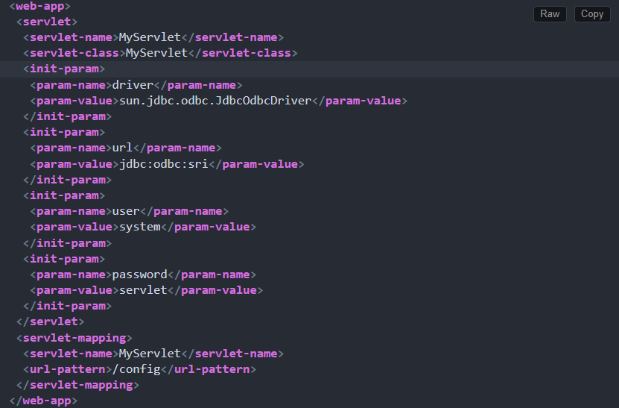

Slide 74
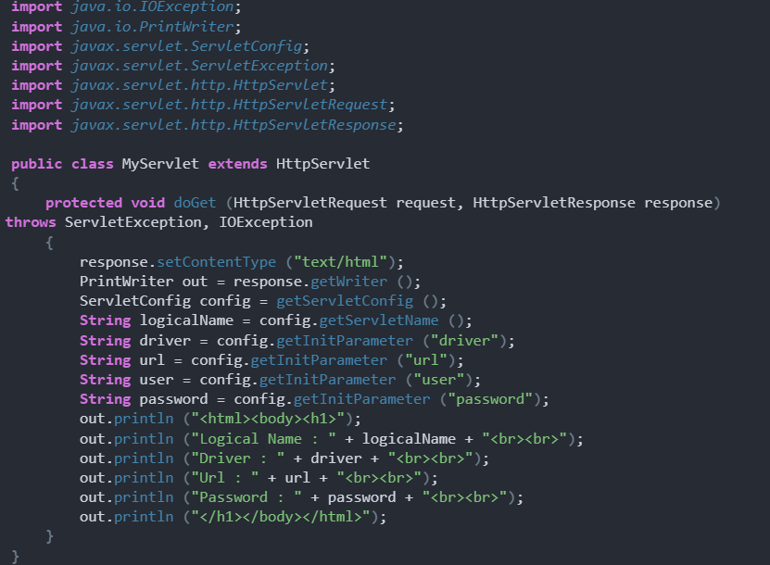

Slide 75
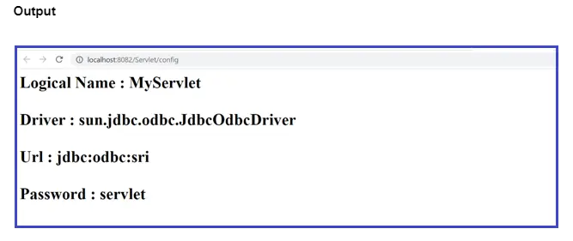

Slide 76
ServletContext Interface
ServletContext is an object, it will manage all the context details of a particular web application, where the context details include the logical name of the web application and context parameters, and so on.
It will provide a complete view of a particular web application. ServletContext object will be prepared by the container the moment when we start the server i.e. the time when we deploy the web application.
ServletContext object will be destroyed by the container when we shut down the server i.e. the time when we un-deploy the web application.
Due to the above reasons, the life of the ServletContext object is almost all the life of the respective web application.
If we declare any data in the ServletContext object then that data will be shared with all the number of resources that are available in the present web application. Due to the above reason, ServletContext will provide more shareability.

Slide 77
In web applications, the container will prepare ServletContext object irrespective of getting requests from the client. In the web application, ServletContext will allow both parameters and attributes data. Due to the above reason, ServletContext will allow both Static Inclusion and Dynamic Inclusion of data.
ServletContext objects can be created and removed only by the server, not by the programmer.
ServletContext object is created at the time of deploying the project. ServletContext object will be removed by the server when we un-deploy the project.
One servletContext object is created from one project.
The ServletContext object can be used by all the servlets which belong to the particular project. But ServletContext object of one project cannot be used by a servlet which belongs to another project.

Slide 78
Usage of ServletContext Object
It provides an interface between the container and the servlet.
It is used to get configuration information from the web.xml file.
It is used to set, get, or remove attributes from the web.xml file.
It is used to provide inter-application communication.
Syntax:
ServletContext context = config.getServletContext();

Slide 79
Methods of ServletContext
public String getInitParameter(String name): It is used to get the particular context parameter value from ServletContext.
public Enumeration getInitParameterNames(): It is used to get all the context parameter names from ServletContext object.
public void setAttribute(String name, Object value): In the web application, the ServletContext object is able to allow attributes. To set an attribute on the ServletContext object we will use this method.
public Object getAttribute(String name): It is used to get an attribute from the ServletContext object.
public void removeAttribute(String name): It is used to remove an attribute from the ServletContext object.
public Enumeration getAttributeNames(): It is used to get all the names of attributes from the ServletContext obj

Slide 80
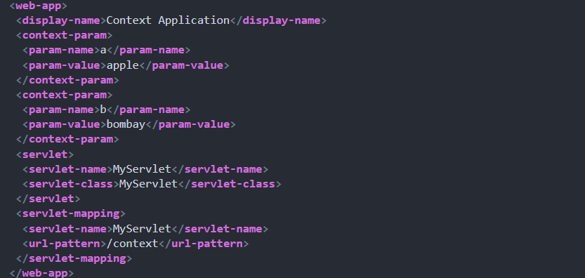

Slide 81
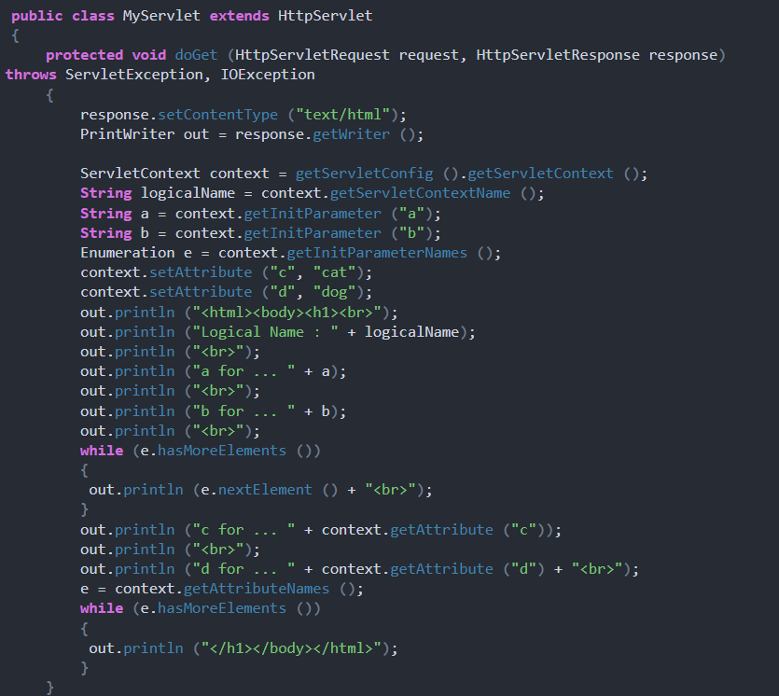

Slide 82
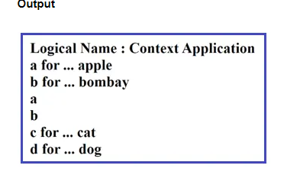

Slide 83


Slide 84


Slide 85


Slide 86


Slide 87


Slide 88


Slide 89


Slide 90


Slide 91


Slide 92


Slide 93


Slide 94


Slide 95


Slide 96


Slide 97


Slide 98


Slide 99


Slide 100

Servlets with JDBC

Slide 101


Slide 102


Slide 103


Slide 104
1)JDBC-ODBC Bridge plus ODBC driver
provides JDBC access via ODBC drivers
Windows platform only
Cannot be used directly from browser (HTTP protocol)
Can be solved by using a middleware such as RMI / CORBA
2)Native-API partly-Java driver
driver converts JDBC calls into calls on the client API
requires that some operating system-specific binary code be loaded on each client machine
3)JDBC-Net pure Java driver
driver translates JDBC calls into a DBMS-independent net protocol,act as middleware server
able to connect its pure Java clients to many different databases -the most flexible JDBC alternative
4)Native-protocol pure Java driver
•converts JDBC calls directly into the network protocol used by DBMS
•This allows a direct call from the client machine to the DBMS server -perfect forInternet JDBC access
•available only by DBMS vendor -Oracle, Sybase etc

Slide 105


Slide 106


Slide 107


Slide 108


Slide 109


Slide 110


Slide 111


Slide 112
Example of Registration form in servlet using JDBC
create a table first as given below:
CREATE TABLE "REGISTERUSER"
( "NAME" VARCHAR2(4000),
"PASS" VARCHAR2(4000),
"EMAIL" VARCHAR2(4000),
"COUNTRY" VARCHAR2(4000)
)
/

Slide 113
register.html
<html>
<body>
<form action="servlet/Register" method="post">
Name:<input type="text" name="userName"/><br/><br/>
Password:<input type="password" name="userPass"/><br/><br/>
Email Id:<input type="text" name="userEmail"/><br/><br/>
Country:
<select name="userCountry">
<option>India</option>
<option>Pakistan</option>
<option>other</option>
</select>
<br/><br/>
<input type="submit" value="register"/>
</form>
</body>
</html>

Slide 114
Register.java
import java.io.*;
import java.sql.*;
import javax.servlet.ServletException;
import javax.servlet.http.*;
public class Register extends HttpServlet {
public void doPost(HttpServletRequest request, HttpServletResponse response) throws ServletException, IOException {
response.setContentType("text/html");
PrintWriter out = response.getWriter();
String n=request.getParameter("userName");
String p=request.getParameter("userPass");
String e=request.getParameter("userEmail");
String c=request.getParameter("userCountry");

Slide 115
try{
Class.forName("oracle.jdbc.driver.OracleDriver");
Connection con=DriverManager.getConnection(
"jdbc:oracle:thin:@localhost:1521:xe","system","oracle");
PreparedStatement ps=con.prepareStatement(
"insert into registeruser values(?,?,?,?)");
ps.setString(1,n);
ps.setString(2,p);
ps.setString(3,e);
ps.setString(4,c);
int i=ps.executeUpdate();
if(i>0)
out.print("You are successfully registered...");
}catch (Exception e2) {System.out.println(e2);}
out.close();
}
}

Slide 116
web.xml file
<web-app>
<servlet>
<servlet-name>Register</servlet-name>
<servlet-class>Register</servlet-class>
</servlet>
<servlet-mapping>
<servlet-name>Register</servlet-name>
<url-pattern>/servlet/Register</url-pattern>
</servlet-mapping>
<welcome-file-list>
<welcome-file>register.html</welcome-file>
</welcome-file-list>
</web-app>

Slide 117


Slide 118


Slide 119


Slide 120


Slide 121


Slide 122


Slide 123


Slide 124


Slide 125


Slide 126


Slide 127


Slide 128


Slide 129


Slide 130


Slide 131


Slide 132


Slide 133



Slide 134


Slide 135


Slide 136


Slide 137


Slide 138


Slide 139


Slide 140


Slide 141


Slide 142


Slide 143


Slide 144


Slide 145
ALL THE BEST!

